Slide 1

NFL Draft Linear Regression Analysis
Samuel Haley

Slide 2
Outline
Research Question
Data
Methodology
Results
Conclusion

Slide 3
Research Question
What factors contribute most significantly to where Running Backs (RBs) and Wide Receivers (WRs) are selected in the NFL draft?

Slide 4
Data
Two datasets:
Players drafted in the 2000 – 2018 NFL Drafts
Team standings and results from the 1999 – 2017 Division I college football seasons
Variable Categories:
Draft Result (pick number)
NFL Draft Combine Information (height, weight, 40 yard dash time, etc.)
Individual College Statistics (games played, yards, touchdowns, etc.)
Team College Statistics (conference, record, ranking)

Slide 5
Methodology – Analysis Steps
Transform rank variables and encode categorical variables
Combine draft results and individual statistics dataset with team results dataset from the year prior
Split players into groups based upon position (RBs, WRs)
Select and normalize variables within each position group
Perform principal component analysis per position to determine number of factors to utilize in subsequent factor analysis
Perform factor analysis per position to identify correlated variables and identify underlying factors
Perform linear regression per position to identify variables that contribute most significantly to draft position

Slide 6
Methodology – Transforming Rank
Problem:
Two variables in the data were ranks from 1 to N:
Draft pick - the dependent variable for the linear regression model
AP Rank – the end of year rank of a player’s college team
These variables were uniformly distributed which violates linear regression’s assumption that all variables are normally distributed
Solution:
Convert ranks into a normally distributed variable by calculating the area to the left of the curve and computing the standard normal distribution’s inverse CDF of that value
Inverse CDF((N + 1 – pick) / (N + 1))
This also had the effect of converting low ranks to high values making linear regression results easier to interpret

Slide 7
Methodology – Encoding Categorical Variables
Problem:
Drafted player’s college conference could provide valuable information to the linear regression model, however it was initially provided as categorical variable
Solution:
“One Hot” encode conference
All division I conferences with 50 or more players drafted were encoded as variables
Remaining division I conferences and non division I players were given a conference of “Other”

Slide 8
Methodology – Normalizing Individual Statistics
Problem:
Individual college statistics were aggregated over their college careers
This reduced the ability of the linear regression model to differentiate dominance and efficiency from experience
Solution:
Yards / Attempts / Receptions / Touchdowns per game statistics were computed to indicate dominance
Yards / Touchdowns per attempt / reception were computed to indicate efficiency
Games played remained to indicate player experience

Slide 9
Results - Principal Component Analysis
Component | RB EVR Cumulative | WR EVR Cumulative
c1 | 0.24857 | 0.246936
c2 | 0.393652 | 0.430913
c3 | 0.501476 | 0.533977
c4 | 0.585316 | 0.60974
c5 | 0.64412 | 0.677979
c6 | 0.696157 | 0.727188
c7 | 0.738346 | 0.766527
c8 | 0.769736 | 0.803012
c9 | 0.796587 | 0.83163
c10 | 0.822348 | 0.858572
c11 | 0.84688 | 0.882502
c12 | 0.86816 | 0.902146
c13 | 0.887504
c14 | 0.9045
The cumulative explained variance ratios resulting from principal component analysis on both RBs and WRs are shown to the left
For both RBs and WRs 9 components were selected to perform further factor analysis

Slide 10
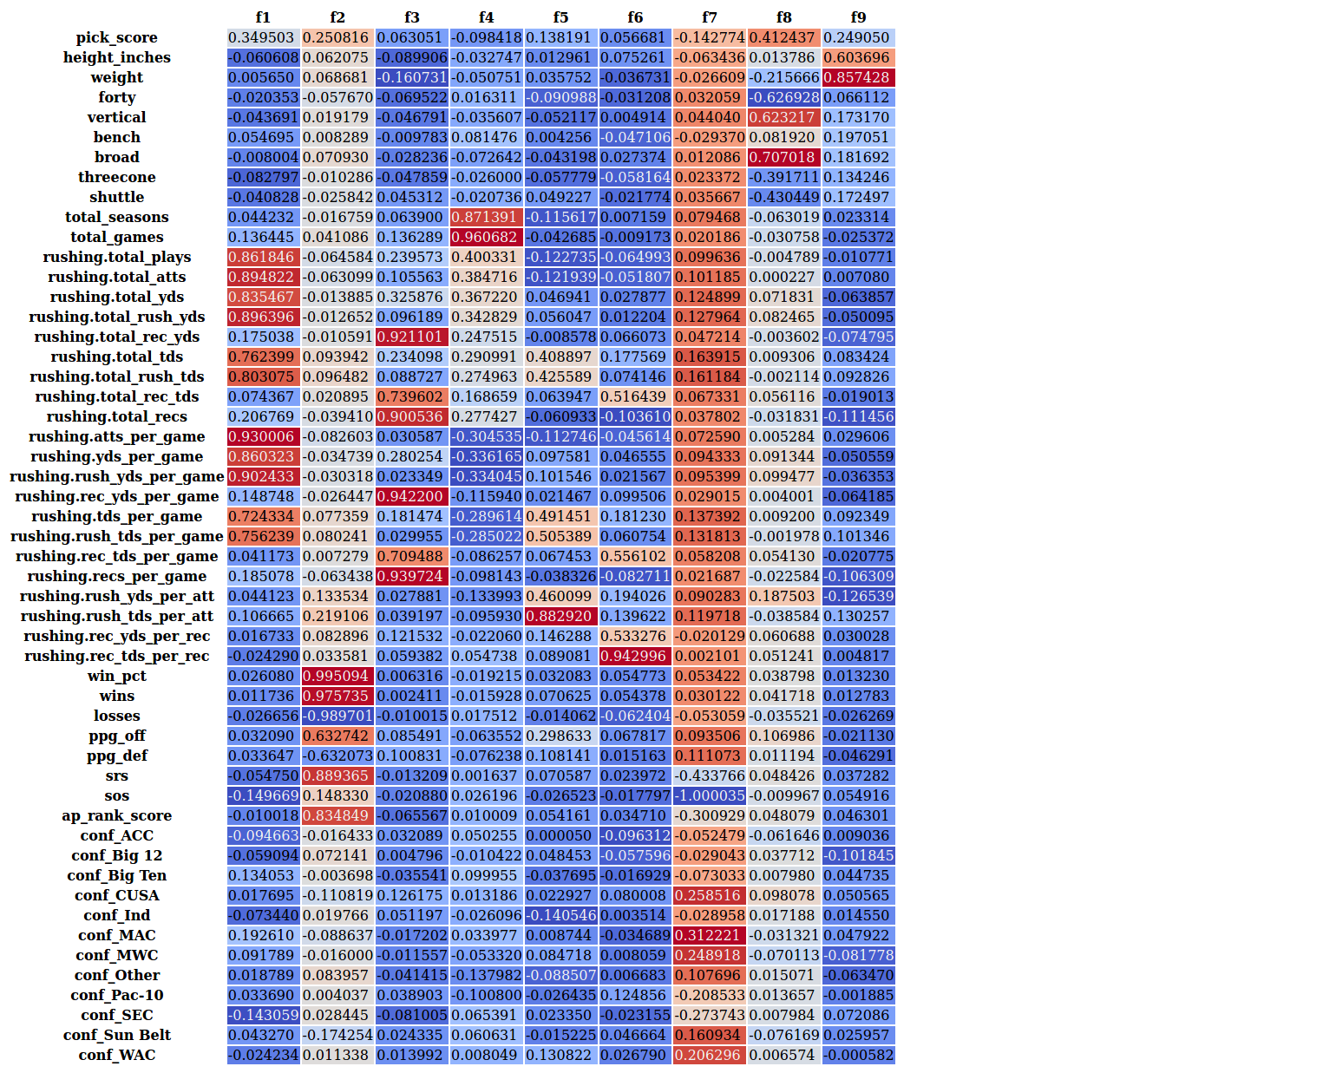
RB Results – Factor Analysis
Factor Interpretation
 | Interpretation | Reduce?
F1 | College Rushing Production | Y
F2 | College Team Success | Y
F3 | College Receiving Production | Y
F4 | College Experience | Y
F5 | College Rushing Efficiency | N
F6 | College Receiving Efficiency | N
F7 | Lesser Conferences | N
F8 | Speed / Power | N
F9 | Size | N

Slide 11
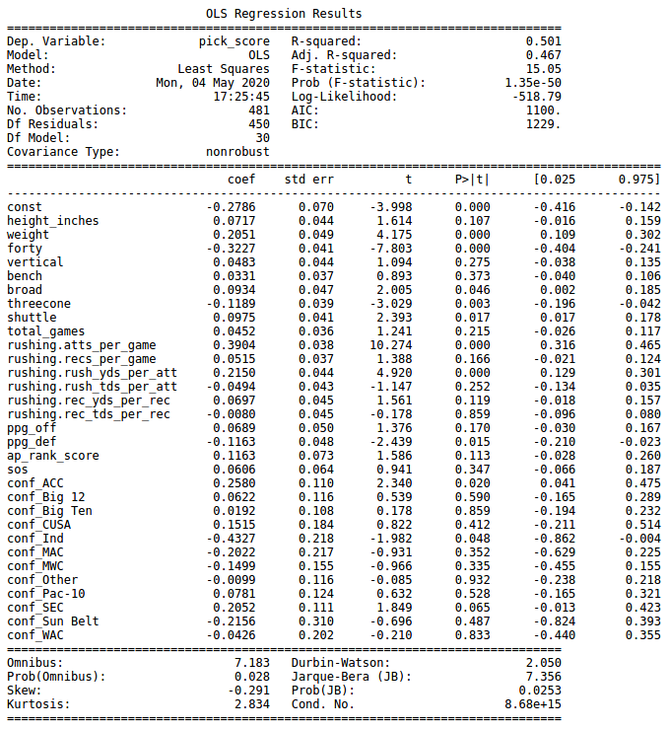
RB Results – Linear Regression
Discussion Points and Interpretations:
Performed slightly better than the receiver regression model
Rushing attempts per game
Strongest association of all variables
High correlation with rushing yards per game
Rush yards per attempt is also highly associated with pick
Total games is not significant
Indicator of rushing production rather than experience
Touchdowns not as important as attempts / yardage
Receiving production is not significant
40 yard dash time
Second highest association with pick and highest among all combine statistics
Coefficient is negative
ACC and SEC are best conferences

Slide 12
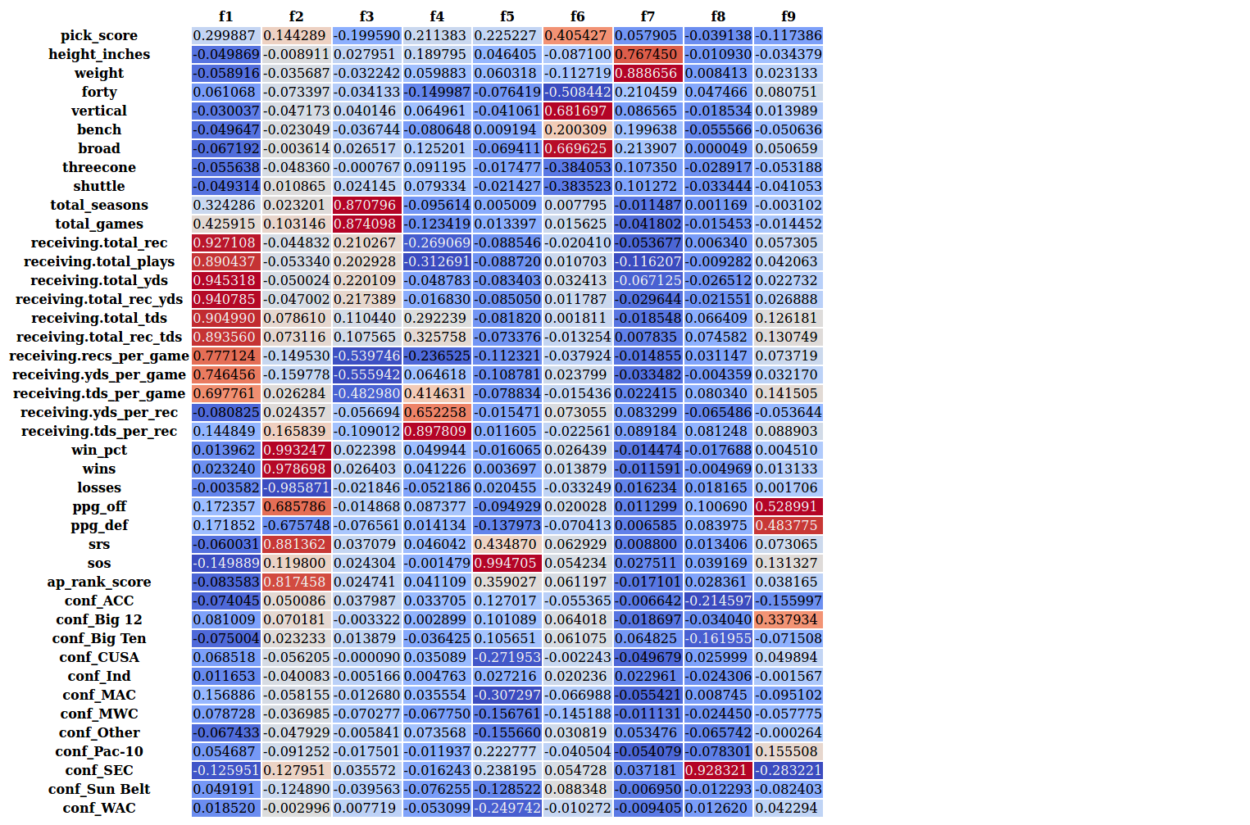
WR Results – Factor Analysis
Factor Interpretation
 | Interpretation | Reduce?
F1 | College Receiving Production | Y
F2 | College Team Success | Y
F3 | College Experience | Y
F4 | College Receiving Efficiency | N
F5 | Stronger Conferences | N
F6 | Speed / Power | N
F7 | Size | N
F8 | From SEC | N
F9 | College Team Scoring | N

Slide 13
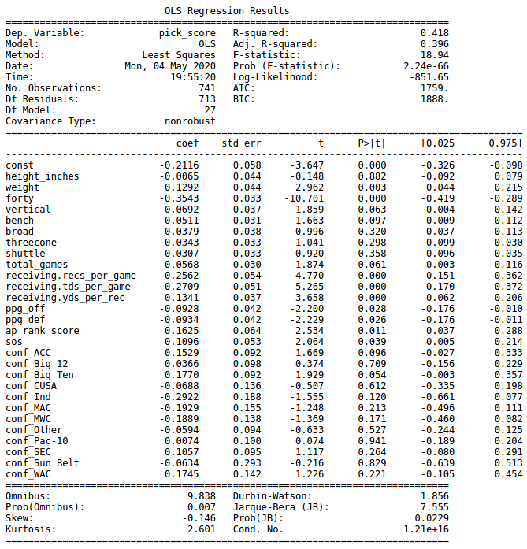
WR Results – Linear Regression
Discussion Points and Interpretations:
Performed slightly worse than the RBs regression model
40 yard dash time has the highest association with pick of all variables
Touchdowns are the most important individual statistic
Height is not associated with pick
Team offensive ppg is negatively associated with pick
Big Ten is the best conference for receivers and the only conference that’s significant at the 90% level

Slide 14
Conclusion – Overall Findings
Answering the main research question:
For RBs college rushing attempts per game and 40 yard dash time contribute most significantly to draft position
For WRs 40 yard dash time and college receiving touchdowns per game contribute most significantly to draft position
Other findings:
40 yard dash is the most important combine statistic for draft selection
College production and efficiency are important factors for getting drafted high; college experience is not
Team success is an important factor for draft selection although team offensive success is not necessarily
Players from the ACC, SEC and Big Ten conferences are drafted higher than players from other conferences

Slide 15
Conclusion - RB vs WR Comparison
Yardage is more important for RBs
Touchdowns are more important for WRs
Team success and strength of schedule is more important for WRs
Offensive points per game is positively associated to draft score for RBs, but negatively associated for WRs
Agility drills (three cone and shuttle) are more important for running backs
RBs from the ACC and SEC are favored, while WRs from the Big Ten are favored

